Slide 1
Data Structures
Course Code: CS-201
Topic: Hashing
Instructor: habiba arshad

Slide 2
CLO Covered
CLO1: Explain the fundamentals of data structure as well as algorithms that operate on them GA2, BT C2
CLO2: Apply and design various data structures methods for specified applications. GA4, C3

Slide 3
Hashing
Hashing is designed to solve the problem to efficiently find or store an item in a collection.
This process of mapping a range of keys (input data) onto an address space is known as hashing.
The function used to find the hash value for a key is called the hashing function.
Using this insertion and search operations are very fast irrespective of the size of the data.

Slide 4
Hashing
It uses hash tables to store the data in an array format. Each value in the array has been assigned a unique index number. Hash tables use a technique to generate these unique index numbers for each value stored in an array format. This technique is called the hash technique.

Slide 5
Hashing
You only need to find the index of the desired item, rather than finding the data. With indexing, you can quickly scan the entire list and retrieve the item you wish.
Indexing also helps in inserting operations when you need to insert data at a specific location. No matter how big or small the table is, you can update and retrieve data within seconds.

Slide 6
Hash Table
The hash table is basically an array of elements, and the hash techniques of search are performed on a part of the item i.e. key. Each key has been mapped to a number, the range remains from 0 to table size - 1
Hash tables are used to store the key-value pairs. The hash table then uses the hash function to generate an index. Hashing uses this unique index to perform insert, update, and search operations.

Slide 7
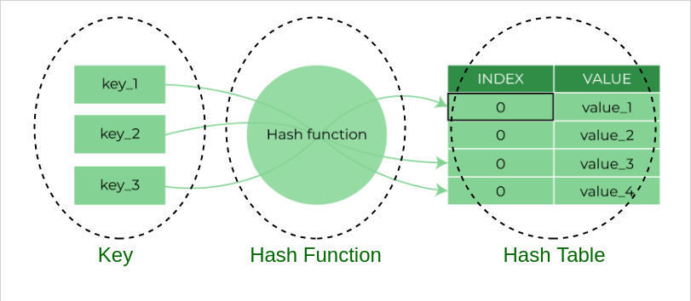
Hashing Process
Hashing in data structure is a two-step process.
The hash function converts the item into a small integer or hash value. This integer is used as an index to store the original data.
It stores the data in a hash table. You can use a hash key to locate data quickly.

Slide 8
Hashing Example
The following are real-life examples of hashing in the data structure –
In schools, the teacher assigns a unique roll number to each student. Later, the teacher uses that roll number to retrieve information about that student.
A library has an infinite number of books. The librarian assigns a unique number to each book. This unique number helps in identifying the position of the books on the bookshelf.

Slide 9
Hash Function
The hash function in a data structure maps the arbitrary size of data to fixed-sized data. It returns the following values: a small integer value (also known as hash value), hash codes, and hash sums.
There may be more than one functions to compute the position to store/retrieve a value in a hash table.

Slide 10
Hash Functions
The principle criteria used in selecting a hash function are as follows
A good hash function is easy to compute.
A good hash function never gets stuck in clustering and distributes keys evenly across the hash table.
A good hash function avoids collision when two elements or items get assigned to the same hash value.
Following are some commonly used Hash Functions:
Division Method
Midsquare Method
Folding Method

Slide 11
Division Method
Choose a number m larger than the number n of keys in K. (The number m is usually chosen to be a prime number or a number without small divisors, since this frequently minimizes the number of collisions.) The hash function H is defined by
H(k) = k (mod m)
Here k (mod m) denotes the remainder when k is divided by m.
For Example:
H(k) = k (mod m)
H(25) = 25 mod 13 m = 13
= 12
Notes:
n = number of keys (data items)
$m$= size of hash table (number of slots)
k = key
It is the data value you want to store or search in the hash table.
Examples of k:
Roll number → 25
ID number → 1023
Any integer key
So in your example:

Slide 12
Simple definition and examples
A hash fn takes a data item to be stored or retrieved and computes the 1st choice for a location for the item.
Data: 15, 558, 32, 132, 102, 5
H(n)= n mod 11
132 |  |  |  | 15 | 5 |  |  | 558 |  | 32
0 | 1 | 2 | 3 | 4 | 5 | 6 | 7 | 8 | 9 | 10
H(15) | 15 mod 11 | 4
H(558) | 558 mod 11 | 8
H(32) | 32 mod 11 | 10
H(132) | 132 mod 11 | 0
H(5) | 5 mod 11 | 5

Slide 13
Midsquare Method
The mid-square method is a hashing technique that generates hash values by squaring the key and then extracting the middle portion of the resulting number. This method is simple and often produces well-distributed hash values, especially when the key values are evenly distributed.
H(k) = l
Where l is obtained by deleting digits from both ends of k². We emphasize that the same positions of k² must be used for all of the keys.
For Example:
H(k) = l
H(25) = 2 25² = 625
Notes:
Keys to Hash: 12, 44, 132, 74
If table size = 100 → extract 2 digits If table size = 1000 → extract 3 digits

Slide 14
Steps for Mid Square Method
Square the Key: Take the numeric key and square it.
Extract the Middle Digits: Select a fixed number of digits from the middle of the squared result. The position and length of these digits depend on the size of the hash table.

Slide 15
Folding Method
The folding method for constructing hash functions begins by dividing the item into equal-size pieces (the last piece may not be of equal size). These pieces are then added together to give the resulting hash value.
For Example:
For example, if our item was the phone number 436-555-4601, we would take the digits and divide them into groups of 2 (43,65,55,46,01). After the addition,
, we get 210.
If we assume our hash table has 11 slots, then we need to perform the extra step of dividing by 11 and keeping the remainder. In this case 210%11 is 1, so the phone number 436-555-4601 hashes to slot 1.

Slide 16
Simple definition and examples
A hash fn takes a data item to be stored or retrieved and computes the 1st choice for a location for the item.
Data: 15, 558, 32, 132, 102, 5
H(n)= n mod 11
If already fill, then stored in next higher empty cell. This process is called collision resolution policy.. Store the number in the next higher unoccupied cell e.g. 257 is stored at position 6.
132 |  |  | 102 | 15 | 5 | 257 |  | 558 |  | 32
0 | 1 | 2 | 3 | 4 | 5 | 6 | 7 | 8 | 9 | 10
H(15) | 15 mod 11 | 4
H(558) | 558 mod 11 | 8
H(32) | 32 mod 11 | 10
H(132) | 132 mod 11 | 0
H(5) | 5 mod 11 | 5

Slide 17
Collisions
When two keys have the same hash value (they map to the same location) we have what is called a collision.
When using a hash table we must have some collision resolution method.

Slide 18
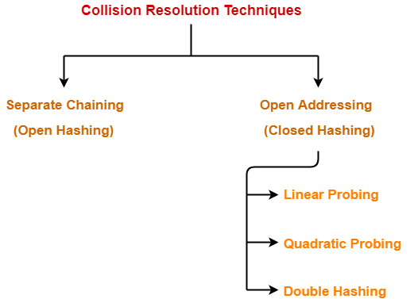

Slide 19
Separate Chaining
To handle the collision,
This technique creates a linked list to the slot for which collision occurs.
The new key is then inserted in the linked list.
These linked lists to the slots appear like chains.
That is why, this technique is called as separate chaining.

Slide 20
Chaining
Chaining involves maintaining two tables in memory.
Hash Address Table
Second Values Table
First table is called Hash Address Table which contains links to the Values Table
Second Tables contains Values Records, where each record consists on Data and a Pointer to the next Record
0
1
2
3
4
5
6

Slide 21
Chaining Example
Insert Keys
h (14) = 14 mod 7 = 0
h (15) = 15 mod 7 = 1
h (20) = 20 mod 7 = 6
h (21) = 21 mod 7 = 0
h (35) = 35 mod 7 = 0
h (17) = 17 mod 7 = 3
0
14
21
35
1
15
2
3
17
4
5
6
and so on…
20

Slide 22
Chaining Example
Using the hash function ‘key mod 7’, insert the following sequence of keys in the hash table-
50, 700, 76, 85, 92, 73 and 101
Use separate chaining technique for collision resolution.
Notes:
https://www.gatevidyalay.com/collision-resolution-techniques-separate-chaining/

